Slide 1
Elevating the Future of Human Resources

Slide 2


Who We Are
Founded in 2020, NOW HR is a premier management consulting firm specializing in human resources. With a deep understanding of industry dynamics and a robust global network, we partner with businesses to craft tailored solutions that address the complexities of the modern workforce.
Our expertise spans executive search, organizational transformation, leadership development, diversity and inclusion, and rewards design. We empower organizations to build high-performing teams, foster inclusive cultures, and navigate challenges in today's competitive landscape.

Slide 3



Company Overview
Empowering Workplaces
Elevating Businesses
Tailored Approach
We help organizations create thriving, people-centric workplaces. Our comprehensive services span the entire employee lifecycle, from talent acquisition to organizational development.
By partnering with our clients, we leverage deep HR expertise and innovative solutions to drive measurable improvements in workforce productivity, engagement, and business performance.
Our customized strategies are tailored to the unique needs of each organization, ensuring we deliver sustainable impact and position our clients for long-term success.

Slide 4

Our Vision
At NOW HR, our vision is to shape a future where businesses and individuals thrive through transformative HR practices and empowered, inclusive workplaces. We believe that by aligning company culture, talent management, and strategic HR initiatives, organizations can unlock their full potential and foster an environment where every employee can contribute and grow.

Slide 5

Our Mission
Delivering World-Class HR Solutions
Fostering Equity and Empowerment
Our mission is to provide innovative, cutting-edge HR solutions that drive organizational performance and unlock the full potential of individuals and teams.
We are committed to promoting diversity, equity, and inclusion in the workplace, ensuring all employees have equal opportunities to thrive and reach their professional goals.
Enhancing Organizational Performance
By aligning HR strategies with business objectives, we enable our clients to maximize productivity, efficiency, and overall organizational effectiveness.

Slide 6





Core Values
Integrity
Innovation
Collaboration
Excellence
Upholding ethical practices in every engagement.
Driving forward-thinking solutions to address today's challenges.
Partnering with clients to co-create impactful strategies.
Delivering measurable, high-quality results.
Inclusion
Fostering diverse and equitable workplaces where everyone belongs.

Slide 7
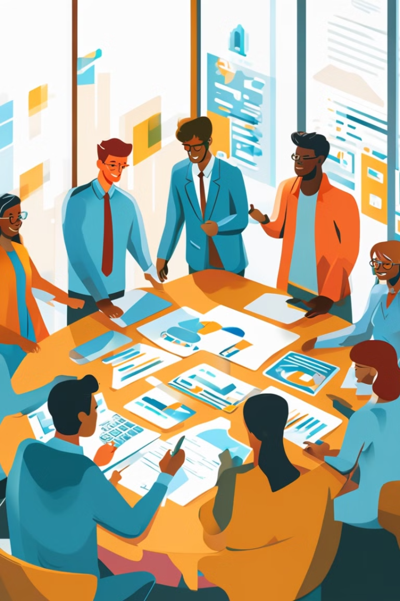
Our Core Services
NOW HR offers a comprehensive suite of services to help organizations build and manage exceptional teams. From executive search and DE&I initiatives to talent management and organizational development, we're your trusted partner for all your human capital needs.

Slide 8
Executive Search and Recruitment
At NOW HR, we understand that exceptional leadership drives organizational success. Our Executive Search and Recruitment services are tailored to help businesses identify and attract the best talent for critical roles. Whether it's a C-suite position or specialized senior leadership, our process ensures that the right individuals are matched with the roles that align with their expertise, values, and the organization's vision.
What We Offer
1
C-Suite and Leadership Placements
2
Specialized and Niche Roles
3
Diversity-Focused Recruitment
Targeted Talent Search: We conduct comprehensive searches to connect your organization with transformative leaders who bring vision and innovation.
Industry-Specific Expertise: We specialize in filling high-stakes roles in industries like finance, technology, retail, and more.
Promoting Inclusive Leadership: Ensuring diverse representation at leadership levels by sourcing talent from underrepresented groups.
Global Reach: Our extensive network spans industries and geographies, enabling access to a diverse pool of top-tier candidates.
Deep Market Insights: Using data-driven insights, we assess industry trends and identify candidates who meet emerging needs.
Unconscious Bias Mitigation: Leveraging structured evaluation processes to maintain equity and objectivity throughout recruitment.
Cultural Alignment: We ensure that candidates not only meet the technical and strategic requirements of the role but also align with your organization's culture and values.
4
Confidential and High-Stakes Searches
For roles requiring discretion, such as CEO, CFO, or other sensitive positions, our approach ensures complete confidentiality while delivering top results.

Slide 9





Talent and Workforce Management
Future-proof your workforce with NOW HR's talent solutions that ensure you attract, retain, and develop the best people.
Service Details:
Competency Frameworks
Succession Planning
Designing models to assess current skills, identify gaps, and guide development.
Building a pipeline of future leaders to ensure continuity in critical roles.
Talent Mapping and Gap Analysis
Workforce Planning
Conducting detailed reviews to identify and fill workforce capability gaps.
Aligning resources with long-term strategic objectives.

Slide 10
Organizational Development and Transformation
Transforming organizations to remain agile, innovative, and aligned with their goals.
Cultural Transformation
Agile Design
Change Management
Shaping organizational values and behaviors to foster a positive and inclusive workplace culture.
Restructuring operations for greater efficiency and responsiveness to market dynamics.
Providing frameworks, strategies, and tools to support seamless transitions during periods of change.
Job Role Optimization
Governance Redesign
Developing job descriptions, grading systems, and competency models to ensure alignment with strategic objectives.
Streamlining organizational structures to enhance decision-making and accountability.

Slide 11
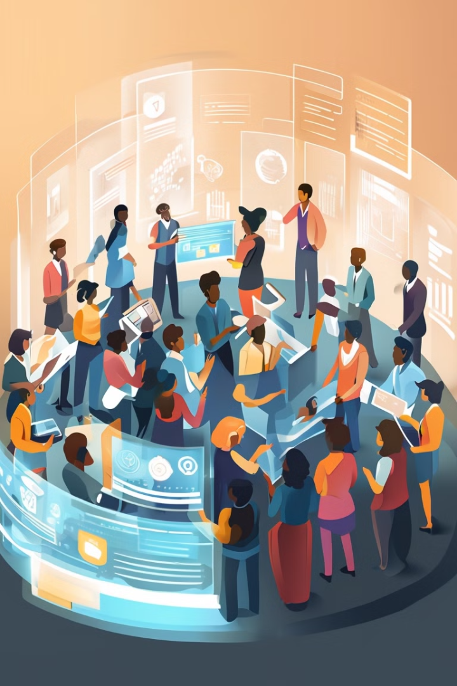




Headcount Rationalization and Workforce Planning
Strategically managing workforce size and structure to align with organizational priorities and optimize resources.
Headcount Rationalization
Workforce Restructuring
Evaluating roles, reducing redundancies, and managing costs while maintaining operational efficiency.
Designing plans to align workforce capacity with business goals during expansions, mergers, or market downturns.
Scenario Planning
Change Management Support
Conducting impact assessments to ensure informed decision-making.
Helping organizations implement headcount changes effectively, minimizing disruption and maintaining morale.

Slide 12
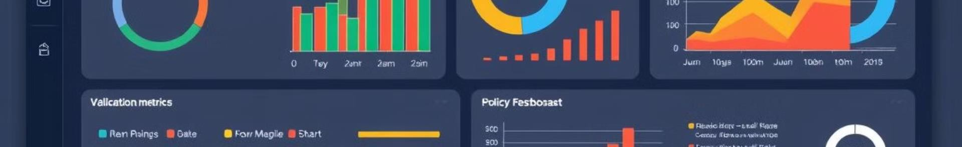
Compliance and Policy Advisory Services
Navigating HR Compliance
Service Details
Navigating HR compliance is critical for risk mitigation and operational success.
Policy Development: Crafting DE&I-focused and business-aligned HR policies.
Compliance Audits: Identifying and addressing gaps in employment laws and internal practices.
Process Standardization: Streamlining HR processes to ensure consistency and efficiency.

Slide 13
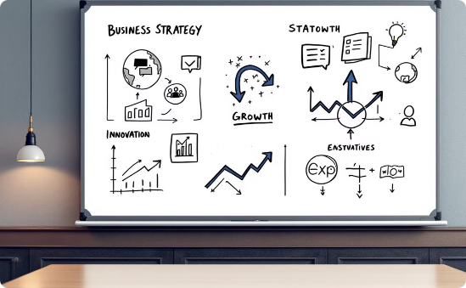
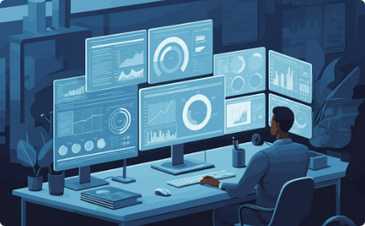

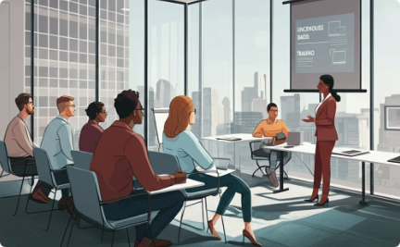
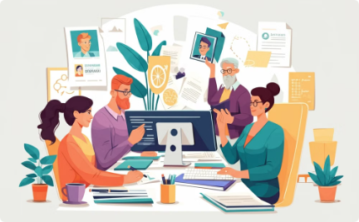
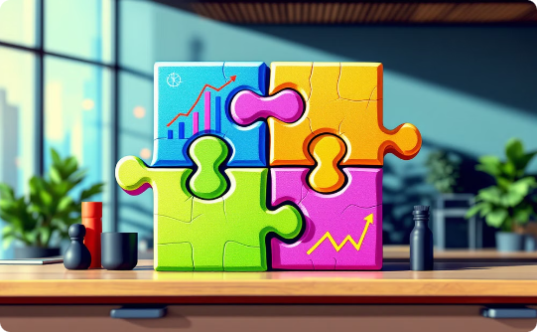
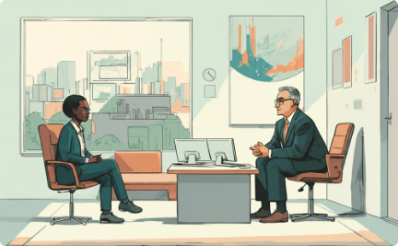
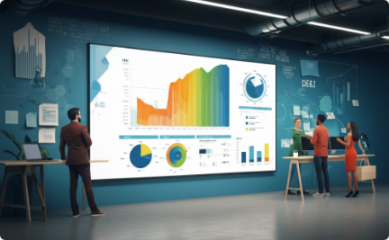
Diversity, Equity & Inclusion (DE&I)
At NOW HR, we understand that building a diverse, equitable, and inclusive workplace is not just a moral imperative but a strategic business advantage. We partner with organizations to embed DE&I principles into their DNA, fostering environments where everyone feels valued and empowered.
DE&I Strategy Development
Diversity Audits
Inclusion Workshops
Diversity Training
Designing actionable, measurable roadmaps tailored to your organization's culture and goals.
Comprehensive evaluations of workforce demographics, policies, and hiring practices to identify areas for improvement.
Interactive sessions to equip leaders and employees with skills to create and sustain inclusive workplaces.
Programs to raise awareness, address implicit biases, and promote fair decision-making.
Policy Review and Redesign
Employee Resource Groups (ERGs)
Leadership Coaching for Inclusion
Metrics and Reporting
Creating equitable frameworks for recruitment, pay equity, promotions, and organizational governance.
Supporting the creation and management of affinity groups to foster belonging and engagement.
Training leaders to champion inclusion and drive cultural change across the organization.
Establishing key performance indicators (KPIs) and dashboards to monitor, measure, and refine DE&I efforts.

Slide 14

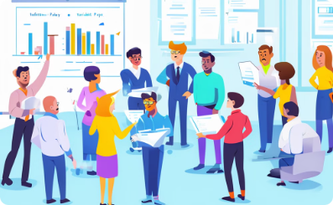

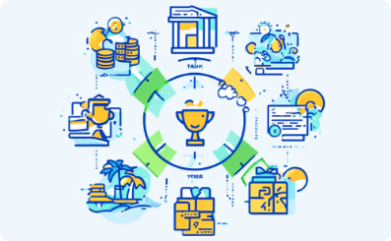
Rewards and Compensation Design
NOW HR designs competitive and equitable reward systems that align with market standards and organizational goals.
Compensation Benchmarking
Variable Pay Programs
Equitable Pay Structures
Total Rewards Strategy
Developing incentive and commission schemes to drive performance and motivation.
Evaluating and aligning salary structures with industry standards and best practices.
Creating frameworks that promote fairness and transparency in compensation.
Combining monetary and non-monetary benefits to attract and retain top talent.

Slide 15
Learning and Development (L&D)
Upskilling for Competitiveness
Leadership Development
Upskilling employees and leaders is essential for staying competitive. NOW HR's L&D services deliver impactful training tailored to your organization's needs.
Programs to enhance strategic thinking, decision-making, and team management.
Inclusive Leadership Training
Technical and Functional Competence
Development
Equipping leaders to create equitable environments and champion diversity.
Focused on industry-specific and job-specific skills development.
Soft Skills Development
E-Learning
Enhancing communication, teamwork, and emotional intelligence across teams.
Crafting tailored e-learning pathways that align with organizational objectives and individual growth.

Slide 16
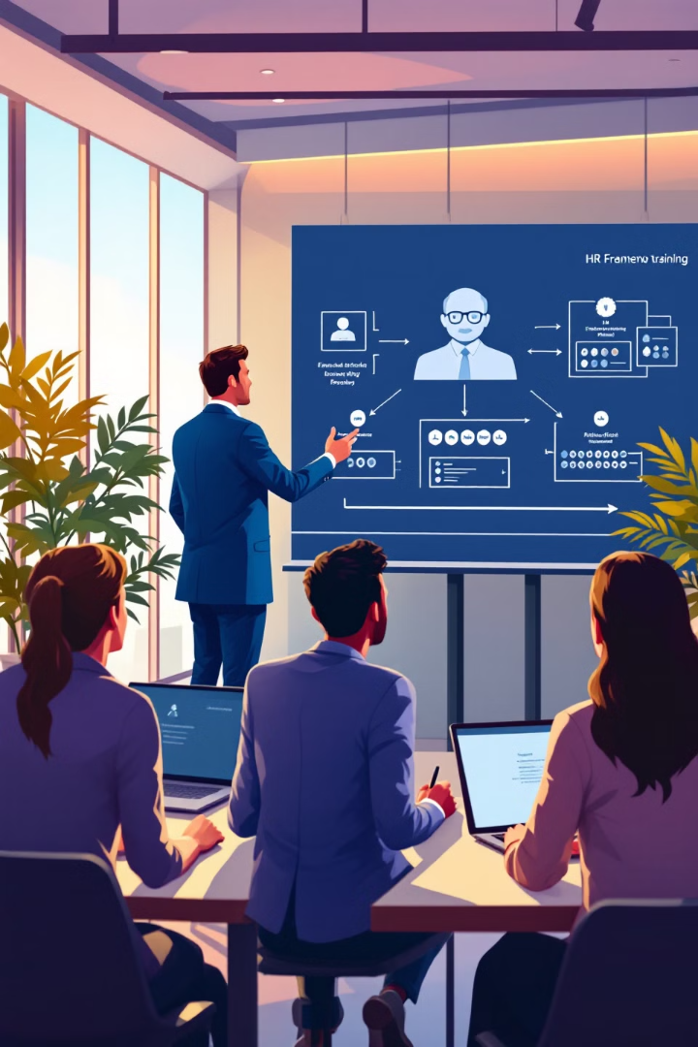
Career Management and Outplacement
Supporting professionals and organizations through career transitions with compassion and expertise.
Personalized Career Coaching
Outplacement Services
Offering impacted employees comprehensive support, including resume writing, interview preparation, and job search guidance.
Helping individuals navigate career challenges and explore new opportunities.
Professional Branding
Crafting resumes, LinkedIn profiles, and cover letters to enhance market visibility.

Slide 17
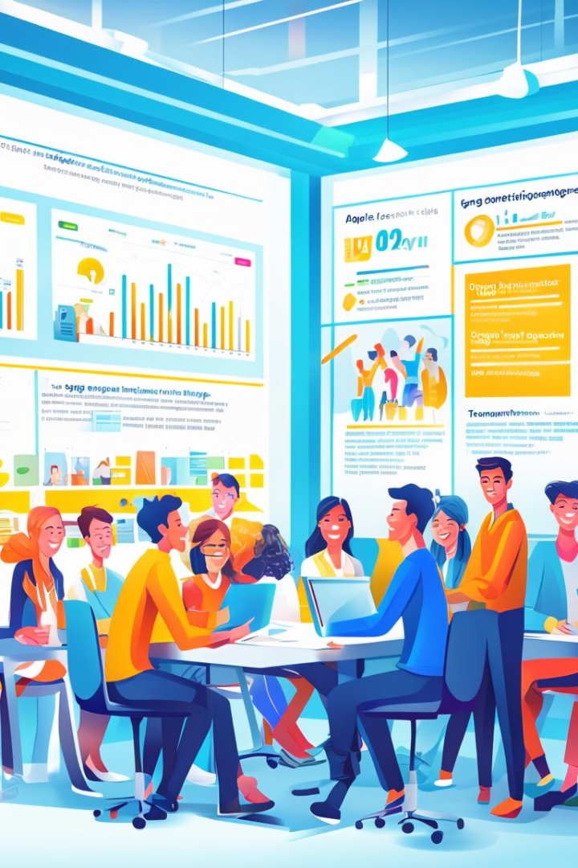
Employee Engagement and Retention
Engaged Employees Drive Performance
Service Details
Engagement Surveys: Identifying factors that impact employee satisfaction and providing actionable insights.
NOW HR helps organizations build cultures that inspire loyalty and productivity.
Retention Strategies: Developing programs to reduce turnover and improve the employee experience.
Culture Change Initiatives: Aligning organizational values and behaviors with business goals to create thriving work environments.

Slide 18




Recruitment Process Outsourcing (RPO)
Efficiently managing the recruitment lifecycle to help organizations save time, reduce costs, and hire quality talent.
End-to-End Recruitment Management
Handling everything from sourcing and screening to onboarding.
Temporary and Bulk Staffing
Delivering skilled candidates for short-term projects or high-volume hiring needs.
Talent Pipeline Development
Building pools of pre-qualified candidates to meet future hiring demands.

Slide 19

SME Outsourcing Services
Let NOW HR Handle Non-Core HR Functions
Service Details
Payroll Management: Managing end-to-end payroll processes to ensure compliance and accuracy.
Let NOW HR handle non-core HR functions so you can focus on your strategic priorities.
HR Process Management: Overseeing employee life cycles, from posting to onboarding, as a third-party provider.
HR Operations: Outsourcing HR administration, including benefits management, attendance, and employee records.
Contract and Temporary Staffing: Providing skilled, vetted professionals for short-term or project-based roles.

Slide 20
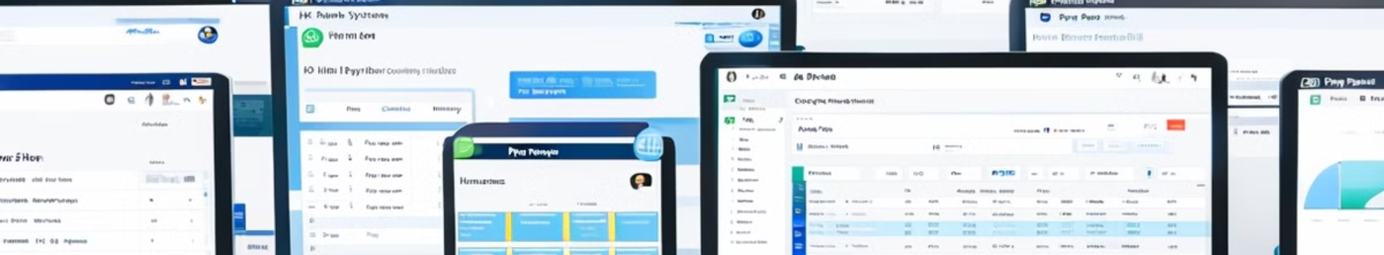



Payroll Outsourcing and HR Technology
Streamline HR operations with advanced technology solutions.
Service Details:
Integrated Payroll Systems
HR Analytics and Dashboards
HR Software Implementation
Ensuring accurate, compliant, and efficient payroll management.
Providing actionable insights to improve HR decision-making.
Supporting the deployment and optimization of HR tools for efficiency.

Slide 21
Third Party Outsourcing
1
Comprehensive Workforce Management
2
Recruitment and Deployment
3
Payroll and Benefits Administration
End-to-End Recruitment Process: Sourcing, interviewing, and selecting candidates tailored to your operational needs. Rapid Deployment: Quickly onboarding staff for time-sensitive or project-based requirements. Temporary and Permanent Placements: Catering to both short-term and long-term workforce demands.
Managing salaries, statutory benefits, and compliance obligations for outsourced employees. Ensuring error-free payroll processing and timely disbursements. Providing benefits like health insurance, leave management, and retirement contributions, as required by law or agreements.
Outsourcing of non-management staff across industries and functions. Ensuring full compliance with labor laws, employment regulations, and industry standards. Handling recruitment, onboarding, payroll, and benefits for outsourced employees.
4
Performance and Attendance Management
5
Compliance and Risk Management
6
Customizable Solutions
Ensuring adherence to all labor regulations, including tax deductions, employee contracts, and workplace safety. Managing risks associated with workforce operations, including liability and dispute resolution.
Tailored outsourcing models based on industry-specific needs. Scalable workforce solutions to align with business growth and seasonal demands. Industry-aligned staffing solutions, including manufacturing, retail, logistics, hospitality, and more.
Monitoring employee performance and attendance to ensure efficiency. Providing detailed performance reports and handling disciplinary actions when necessary. Implementing training programs to upskill and enhance employee productivity.
7
Operational Cost Optimization
Reducing overhead costs associated with managing non-management staff in-house. Streamlining workforce operations to improve efficiency and profitability.

Slide 22





Expert Consulting Team
Industry Experience
Our consultants bring extensive experience in HR practices, ensuring tailored solutions for Mobilink Microfinance Bank.
Global Expertise
Well-versed in international HR standards and best practices, our team provides a global perspective to enhance your HR policies.
Data-Driven Approach
We utilize advanced analytics and benchmarking methodologies to deliver evidence-based recommendations and solutions.
Collaborative Style
Our consultants work closely with your team, ensuring seamless integration of new policies and
fostering organizational buy-in.

Slide 23

Our Leadership Team
Mehek Nadeem
Mehek comes with a decade + years of experience in the Recruitment Services Industry. She has successfully partnered with MNCs and Local Progressive Organizations across Pakistan and internationally to help build their Senior Leadership Teams. With deep sector and functional knowledge, Mehek comes with a proven track record of placing some of the top executives in renowned Organizations across Pakistan and globally.
Having spent a considerable period with her previous employer HRSG, Mehek has prominently led assignments related to Executive Search, Career Counseling, Staffing, Talent Pipelining, Leadership Assessments and Outplacement assignments.
Amongst some of the key clients that Mehek has serviced are Engro, Schneider Electric, PTCL, Daraz, BASF, Roche, ICI, KIA Lucky Motors, Unilever, IGI, DP World, TCS, EBM, RB, Kellogg’s, General Tyre, Transworld associates, NBP, Adamjee Insurance, Gerry’s Group, Askari Insurance, International Industries, PPL, PSO, Microsoft, Mckinsey, Vitol Group Dun and Bradstreet, Army Welfare Trust, TRG, LUMS, ICAP, Habib University, TCF, Aman Foundation, Indus Hospital, AKU, The City School, NBP, Systems Limited, Pakistan Stock Exchange, Hashoo Group, Artistic Apparel, Dalda, Iffco, Nielsen, Liberty Group, Hapag Lloyd, Habib Bank AG Zurich, Sika Pakistan.
Mehek has graduated from The University of Waterloo, Canada in 2010 with a degree in Bachelor of Arts. She is also a Certified Assessor for Leadership Assessments from the Talent Enterprise, Dubai.

Slide 24
Our Leadership Team
Salman Modan
Salman Modan serves as a Senior HR Consultant for NOW HR co-leading our key Organizational Consulting division. With over 14 years of HR experience under his belt along with a global Chartered license, he is a Shell Asia Pacific Lubricants Supply Chain Leadership Team Member, Shell Asia Pacific Lubricants Learning & OD Leadership Member, Ex- Shell Pakistan HR Leadership Team Member and HR Representative in SPL Crisis Management Team, D,E&I Champion, Job Evaluation Qualified, Trained Assessor & Coach.
He is a subject matter expert in the areas of People Strategy & Performance, Organization Design & Development, Leadership Development, Change Management, Recruitment HR Digital Transformation, Culture, Learning & Capability Development, Talent Management, Total Rewards, Policy, Employee Relations and Engagement.
An award-winning leader, he has coached and led talent across various levels, making a lasting impact on both senior leaders and frontline teams in challenging environments
Salman is CIPD Essentials Qualified has graduated from The University of Nottingham with a degree in Business Management – He has majored in Finance, Accounting and Management with Minors in Organizational Psychology.

Slide 25
Our Leadership Team
Muhammad Ali
Muhammad Ali comes with substantial experience of working in the recruiting industry. He started his career at HRSG Recruiting, where he was responsible for executive search and recruitment for leading organizations in the Oil & Gas and Tech industry. Over the years, Muhammad has worked extensively with leading organizations in the public and private sector. He has a passion for sourcing and recruiting top talent and thrives on working with clients to support them in building their teams with the most talented and exceptional players in the market.
Some of the prominent clients that Muhammad has serviced include UEP, Total Parco, Eni Pakistan, Vitol, Byco, China Three Gorges, BE, Hascol, Schlumberger, K-Electric, KAPCO, Uch Power, ISGS, SSGC, OCAC, OGDCL, POL, General Tire, ICBC, Askari Life Insurance, IGI Securities, Orix Leasing, Naveena Textile, Al Razzaq Fibers, Abu Dawood, Dawood Hercules, TPL Corp, Oracle, Zameen.com, Convo, Kenwood, Emaar, House of Habib etc.
Muhammad holds a Bachelor in Arts degree in Business Management from the Middlesex University and is skilled in C-Suite Executive Search, Technical Recruiting and client relationship management.

Slide 26
Our Leadership Team
Zainab Moiz Siddiqui
Zainab comes with extensive HR experience in the recruitment/training domain while initiating her career with a textile giant in the
capacity of a training and recruitment executive following her experience with HRSG as a Recruitment Consultant.
Zainab has solely handled a critical client portfolio of companies comprising of the tech, telecom and media sector alongside working on roles from the FMCG, Logistics, NGO and Start-up sectors as well. Her prominent clientele include Zong, Wateen telecom, Huawei, WorldGroup, Akhuwat Foundation, Transworld Enterprises, Vava Cars, Rohde & Schwarz, PPAF, Assa Abloy, Good-core software, MachineSells, EZBuy Pakistan, RedTone. Communications, Pioneer Seeds, IAL Saatchi, Bulls Eye Communications, Digitz, Careem, GSK Pakistan, ISL, Hilal Foods, Geo Jang Group, Rafhan Maize, etc.
Zainab is an HR Graduate from the Institute of Business Management and has had the exposure of working with local giants as well as multi-nationals for C-suite level recruitment. Zainab is also a certified assessor for the strength-based tool ‘The Thriving Index’ designed by the Talent Enterprise, UAE. She is a prompt and efficient worker when it comes to searching for the right talent and thoroughly understands client needs in order to assess and fill critical roles.

Slide 27
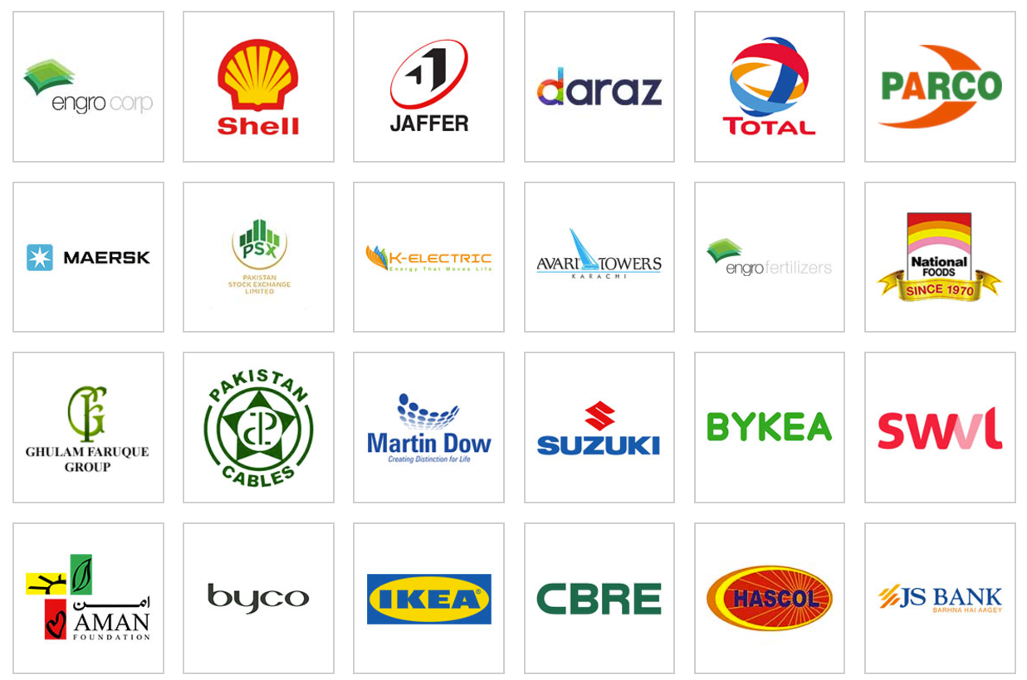
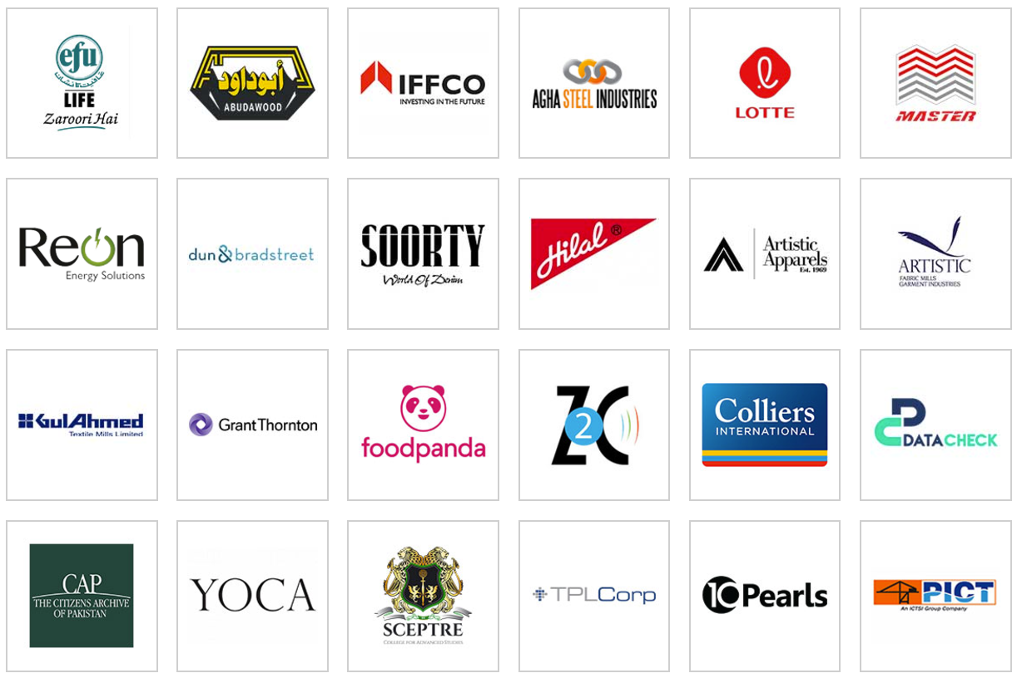
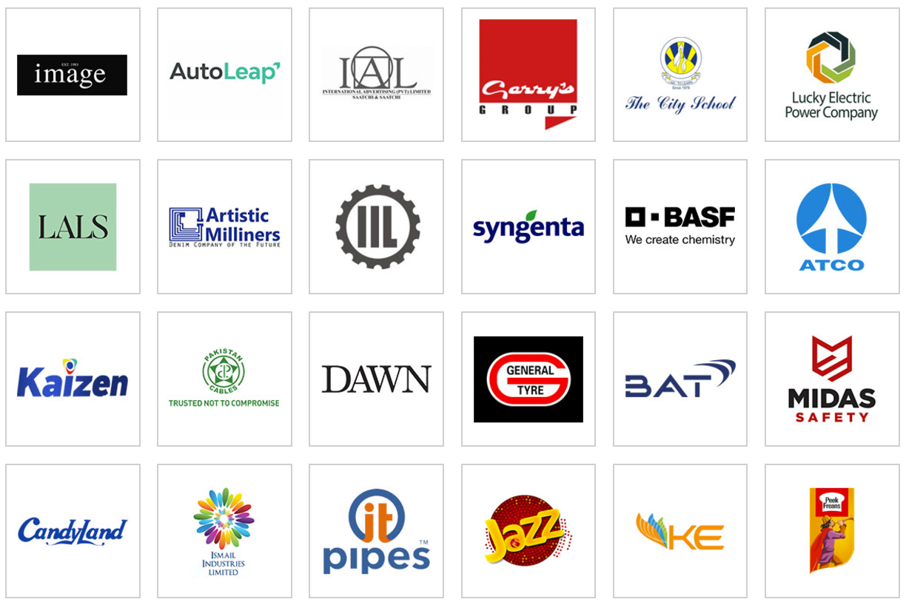
Our Clients: Top Fortune 500 Companies
& Local Conglomerates

